Slide 1
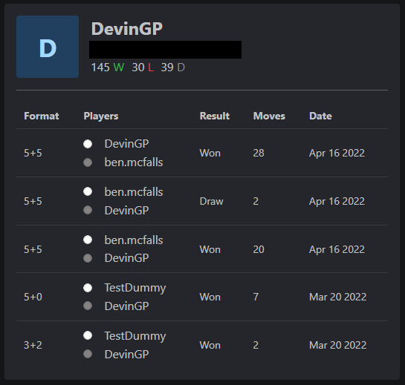
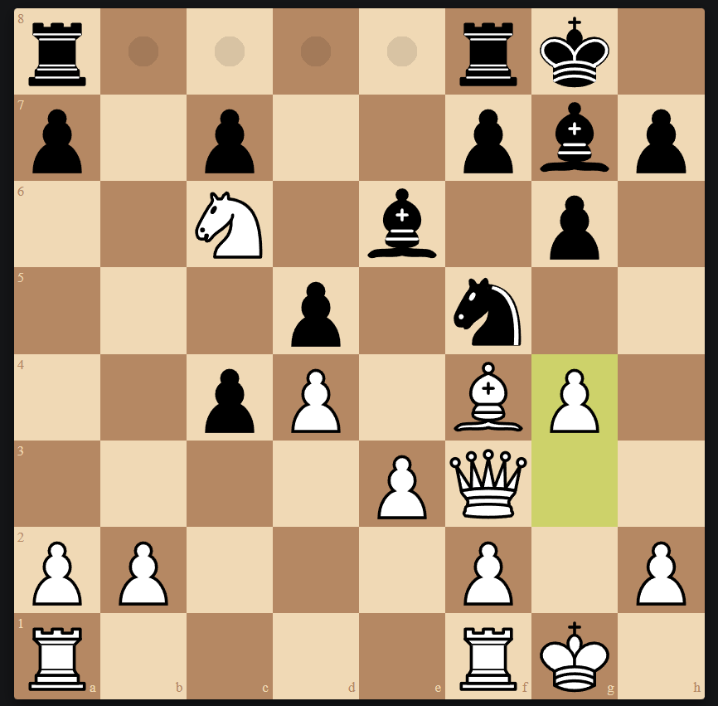
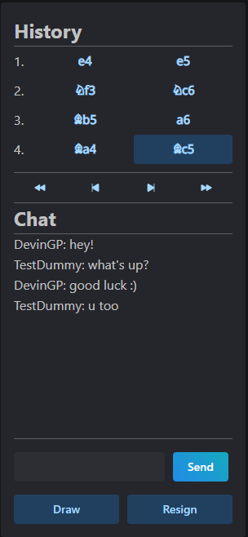


Chess Game
Kevin Jusino
Hilary Lumeh
Benjamin McFalls
Devin Parentice
Emilia Quintana
https://github.com/bam1098/JuLuMcPaQu-468
This project allows users to play chess and chat in real time with one another
The user’s match history is saved, and users can view their stats and past games
Kubernetes System with CI/CD Pipeline via Jenkins
Socket.io:
Handles sending chess moves between players in real time
React frontend
Client 1
Database: MongoDB
Stores user information
Node Backend
React frontend
Client 2
Express Server:
Handles DB queries and connecting frontend to backend
React frontend
Client N

